Slide 1
CREDIT EDA CASE STUDY
By Rahul Tanpure and VIKRAM Gandham

Slide 2
In this case study, we develop a basic understanding of risk analytics in banking and financial services and understand how data is used to minimize the risk of losing money while lending to customers.
Introduction
Problem Statement
If the applicant is likely to repay the loan, then not approving the loan results in a loss of business to the company
If the applicant is not likely to repay the loan, i.e. he/she is likely to default, then approving the loan may lead to a financial loss for the company.
This case study aims to identify patterns which indicate if a client has difficulty paying their instalments which may be used approving / denying the loan.
In other words, the company wants to understand the driving factors (or driver variables) behind loan default, i.e. the variables which are strong indicators of default. The company can utilize this knowledge for its portfolio and risk assessment.
Approach
Checking the % of null values in columns and dropping the columns which have >= 45% missing data
Check for outliers Impute with most occurring value for Categorical columns
Impute with median value for Non-Categorical columns
Check the imbalances in the data (Univariate Analysis)
Merge the 2 data sets (Application & Previous Application)
Perform Bivariate Analysis to gather final insights.

Slide 3
The below slides include analysis done for Target 1 named as ‘Default’ and Target 0 named as ‘Non - Default’ and concluded in the end

Slide 4
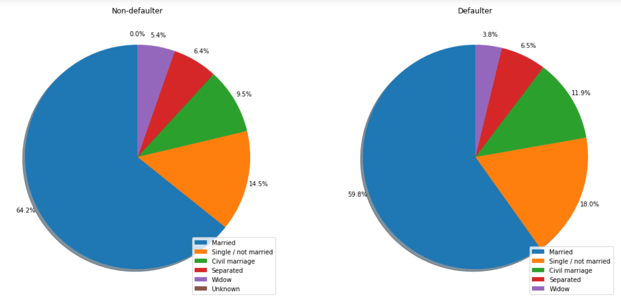
Distribution of income type
NAME_FAMILY_STATUS
Points to be concluded from the chart on the right.
Defaulters have a higher percentage of single and civil married people.
The percentage in non-defaulters for married is higher than that of defaulters.

Slide 5
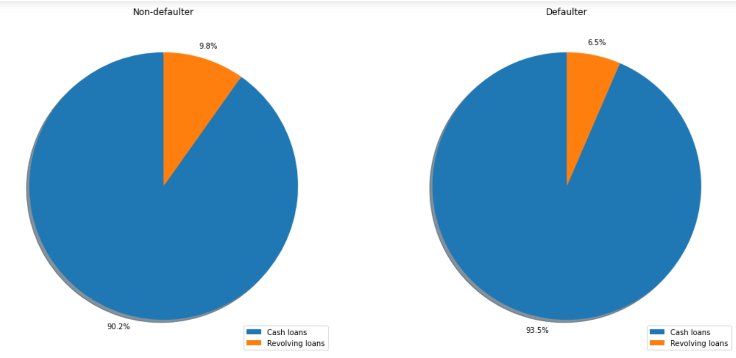
n for contract type
NAME_CONTRACT_TYPE
Points to be concluded from the chart on the right.
cash loans have high percentage in defaulters & non Defaulters
Revolving loans have less percentage in defaulters & non Defaulters

Slide 6
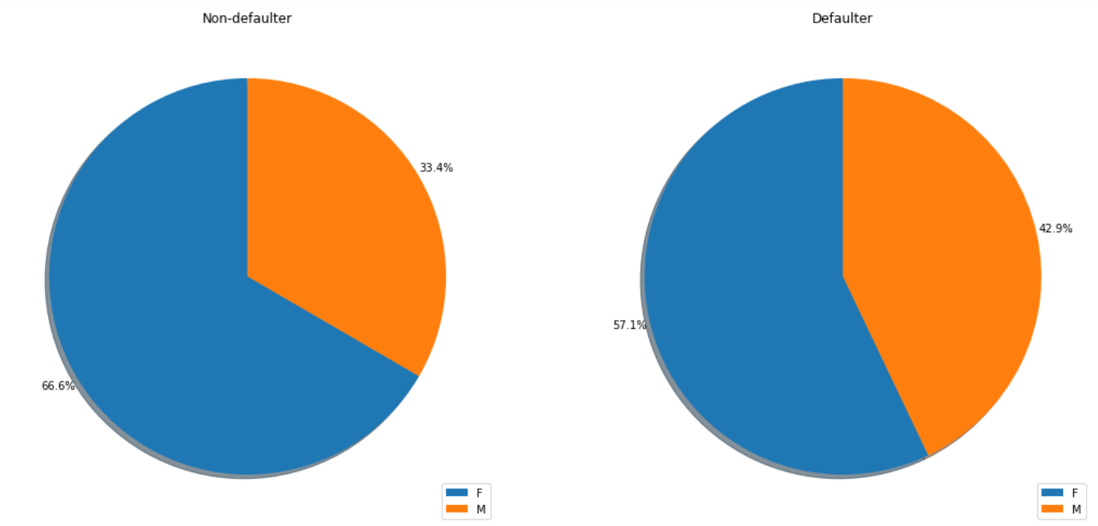
Distribution of organization type
CODE_GENDER
Points to be concluded from the chart on the right.
Females are in majority in both defaulter and non defaulter
Male percentage is more in defaulter.

Slide 7
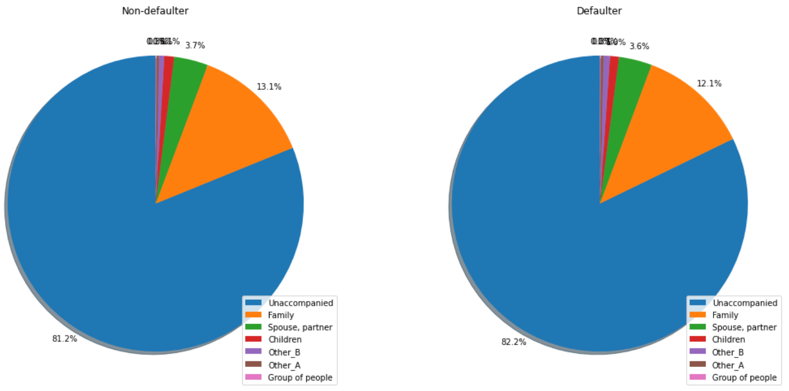
Distribution of organization type
NAME_TYPE_SUITE
Points to be concluded from the chart on the right.
Unaccompanied ones are higher in both defaulter and non defaulter

Slide 8
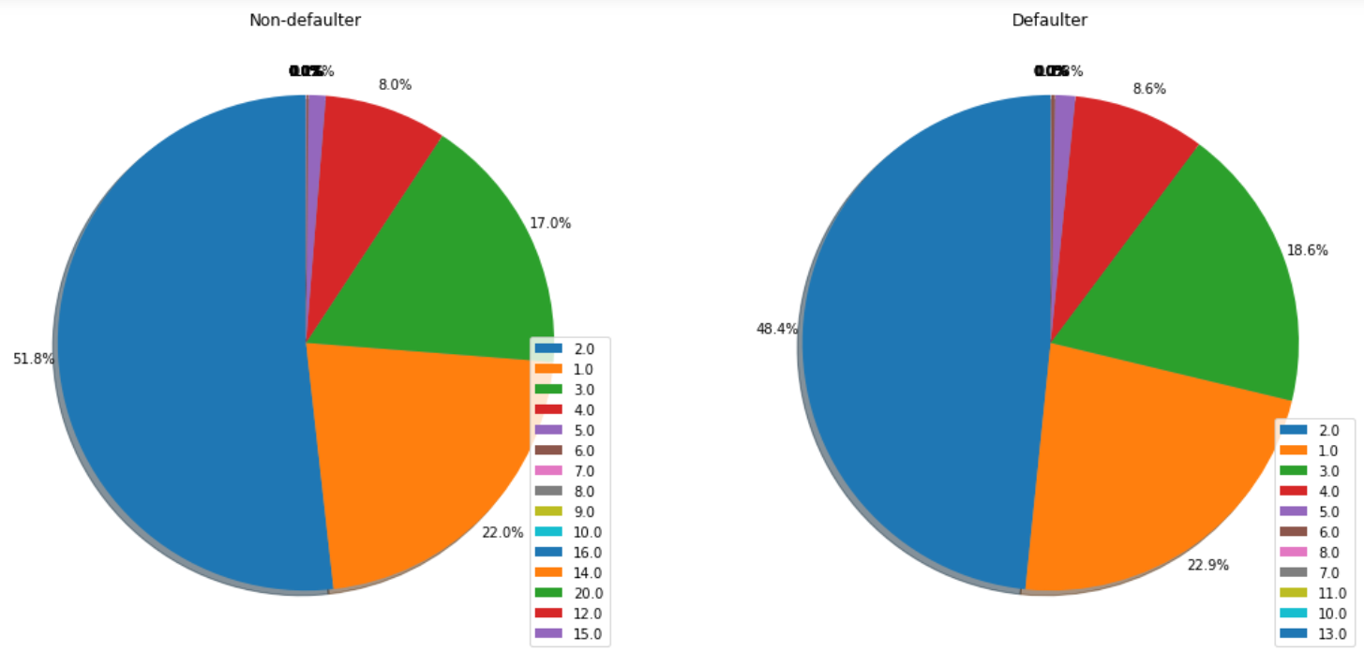
Distribution of organization type
CNT_FAM_MEMBERS
Points to be concluded from the chart on the right.
Family members of 2 have high percentage in both defaulter and non defaulter.

Slide 9
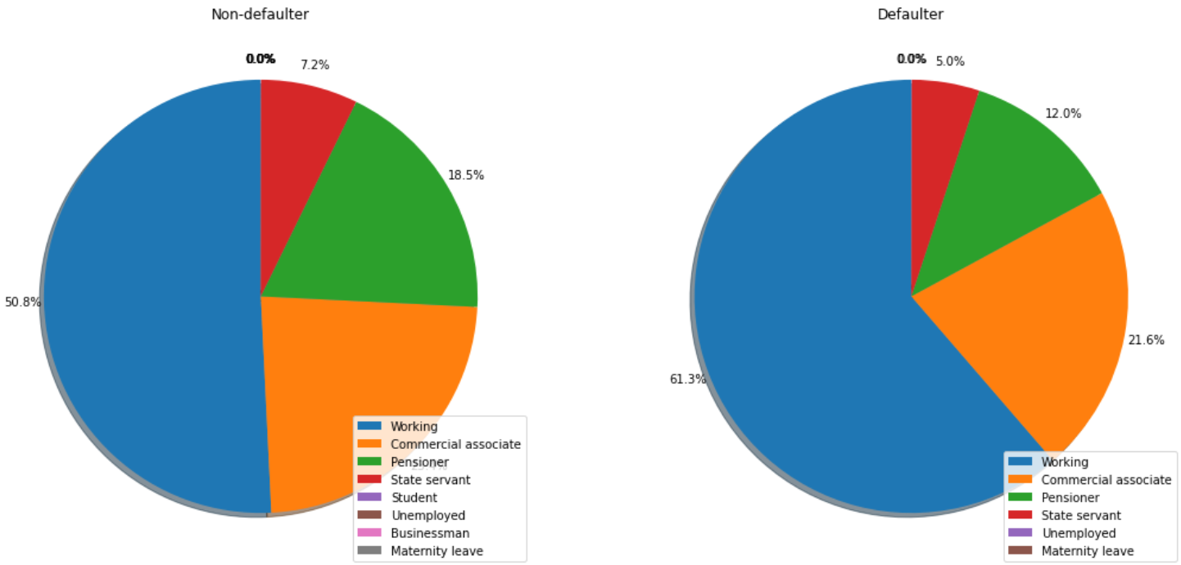
Distribution of organization type
NAME_INCOME_TYPE
Points to be concluded from the chart on the right.
Working professionsals have highest percentage in defaulter.
State servants are the non defaulters.

Slide 10
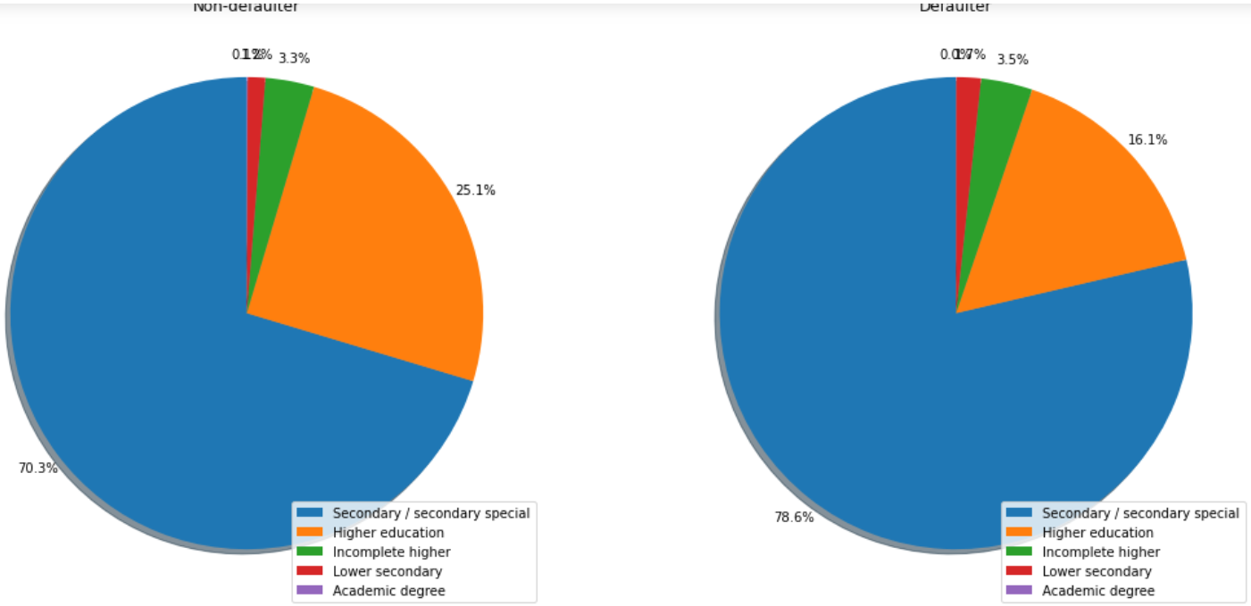
Distribution of organization type
NAME_EDUCATION_TYPE
Points to be concluded from the chart on the right.
People with Secondary education have highest percentage in defaulter.
People with Higher education have highest percentage in Non defaulter

Slide 11
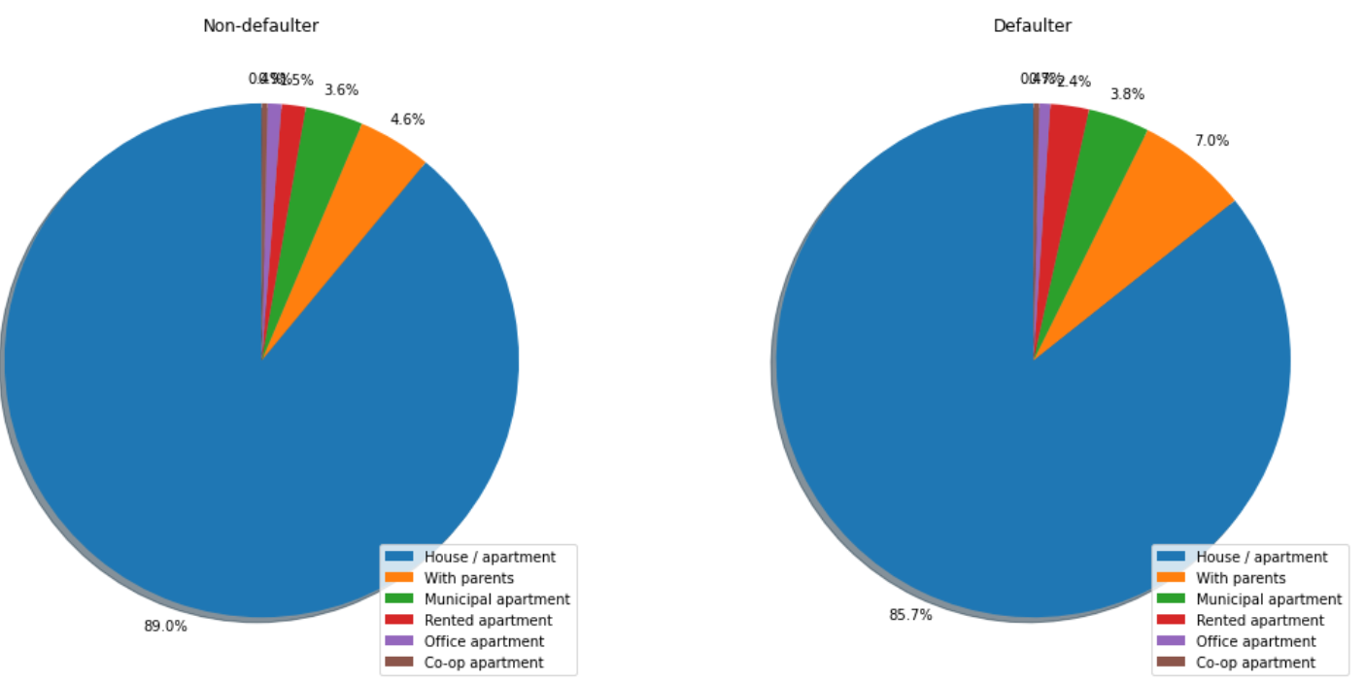
Distribution of organization type
NAME_HOUSING_TYPE
Points to be concluded from the chart on the right.
Defaulters have a higher percentage of living with parents.
The percentages of non-defaulters have houses is higher than that of defaulters.

Slide 12
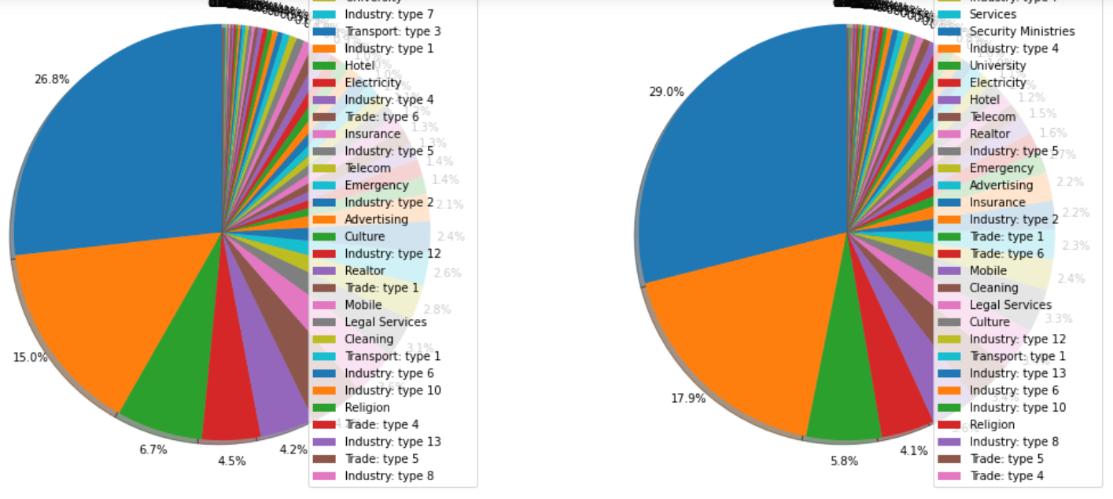
Distribution of organization type
ORGANIZATION_TYPE
Points to be concluded from the chart on the right.
Clients which have applied for credits are from most of the organization type ‘Business entity Type 3’ , ‘Self employed’ , ‘Other’ , ‘Medicine’ and ‘Government’.
Less clients are from Industry type 8,type 6, type 10, religion and trade type 5, type 4.

Slide 13
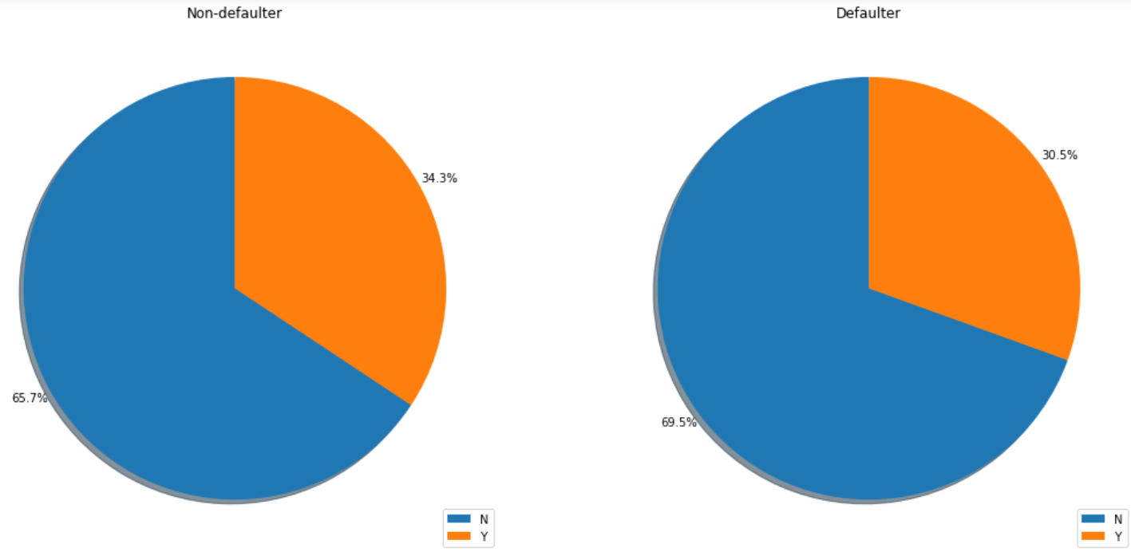
Distribution of organization type
FLAG_OWN_CAR
Points to be concluded from the chart on the right.
People who do not own car are most likely to default as they have higher percentage

Slide 14
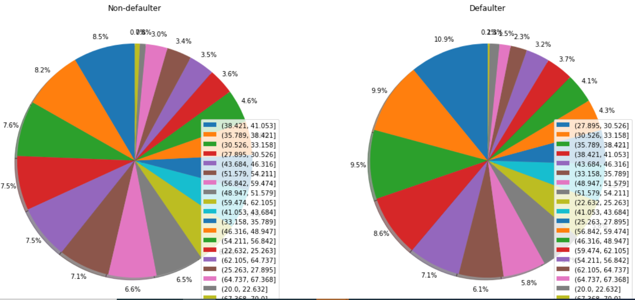
Distribution of organization type
AGE_GRP
Points to be concluded from the chart on the right.
People in the age bracket of 27-33 are most likely to default as they have higher percentge in defaulters.

Slide 15
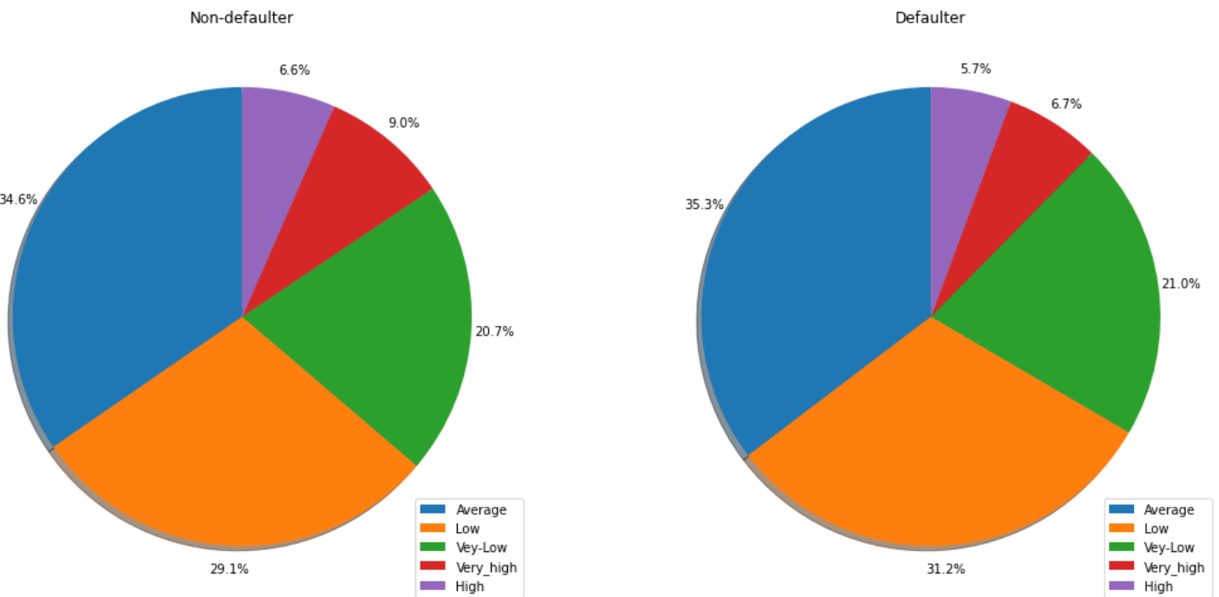
Distribution of organization type
INCOME_GRP
Points to be concluded from the chart on the right.
The percentage of defaulters having low income and average income is higher than that of non-defaulters.

Slide 16
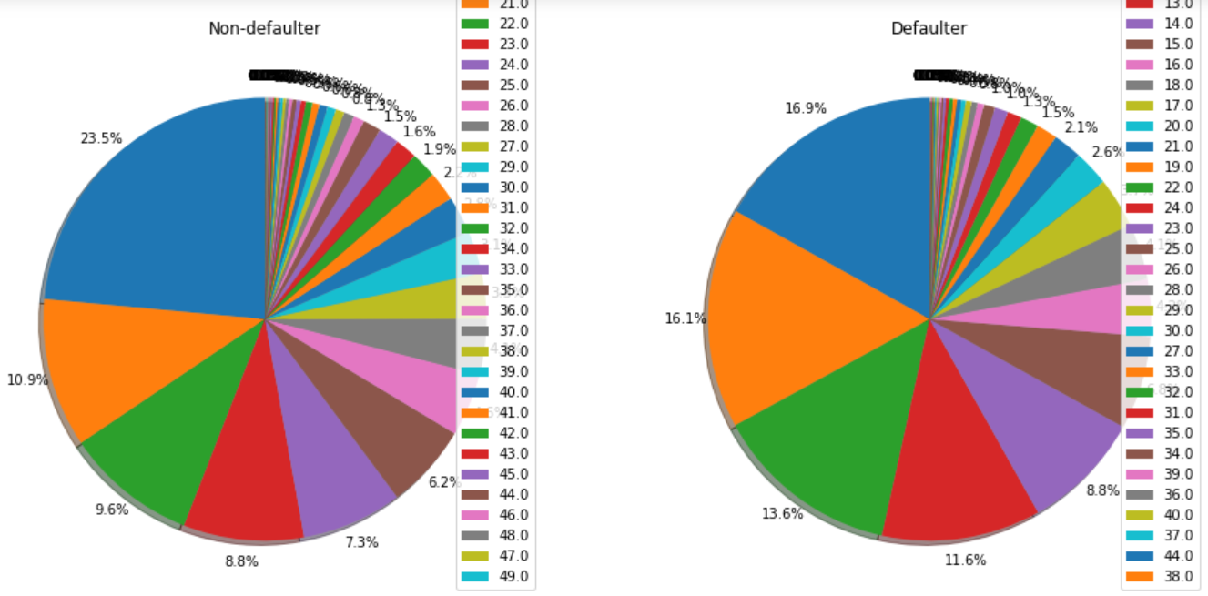
Distribution of organization type
WORK_EXP
Points to be concluded from the chart on the right.
People with 1-3 years of work experience are most likely to default as they have higher percentage in defaulters

Slide 17
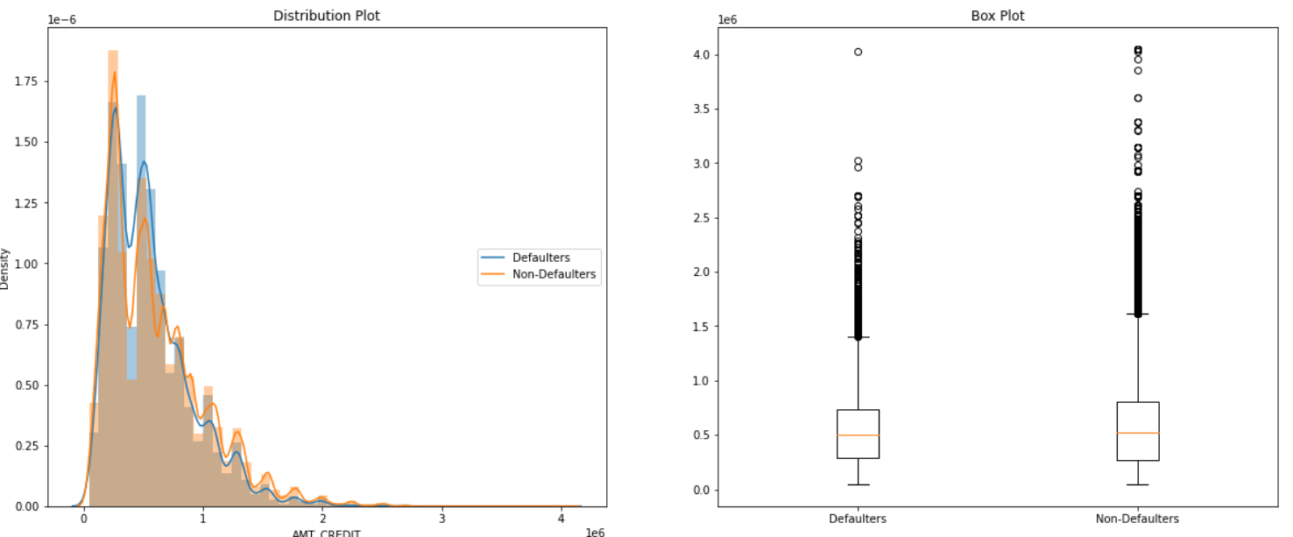
Distribution of organization type
AMT_CREDIT
Points to be concluded from the distribution on the right.
The distribution is quite similar between Defaulters and non-Defaulters. Therefore, from the boxplot, it can be seen that the medians of defaulter and non-defaulters are almost equal.
The outliers of non-defaulters have higher values than defaulters. Loan amount upto 50000 - 75000 and 125000 -200000 are likely to be more defaulters

Slide 18
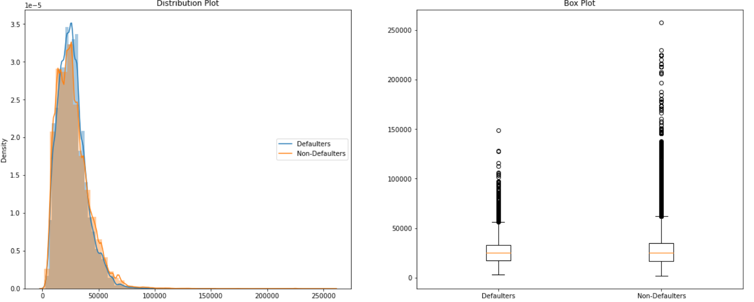
Distribution of organization type
AMT_ANNUITY
Points to be concluded from the graphs on the right.
From the boxplot, it can be seen that the medians of defaulter and non-defaulters are almost equal.
People who are repaying loan between 20000 to 40000 are more likely to be defaulters

Slide 19
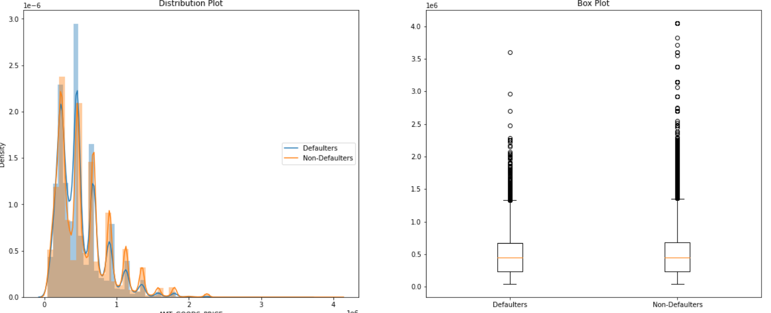
Distribution of organization type
AMT_GOODS_PRICE
Points to be concluded from the graph on the right.
People who are taking loan for goods whose price is 20000 to 60000 are defaulters.
From the boxplot, it can be seen that the medians of defaulter and non-defaulters are almost equal. The outliers of non-defaulters have higher values than defaulters.

Slide 20
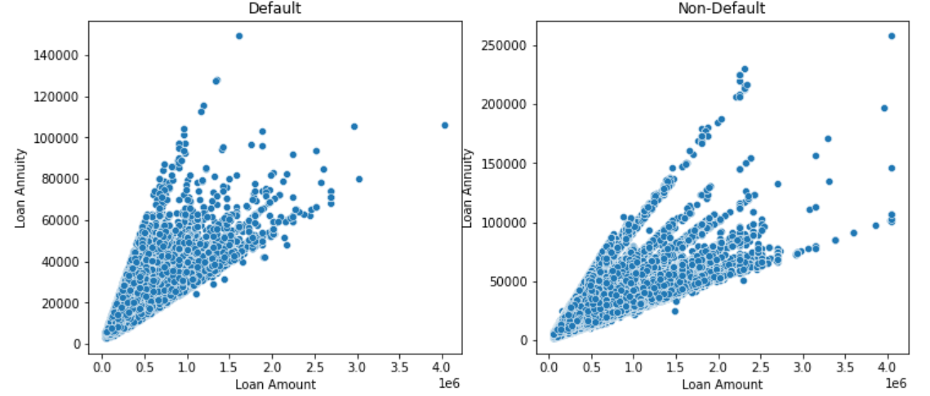
Distribution of organization type
AMT_ANNUITY’ vs 'AMT_CREDIT
Points to be concluded from the graph on the right.
Loan annuity and loan amount both are directly related.
Defaulters are mostly who has taken loan for large amount

Slide 21
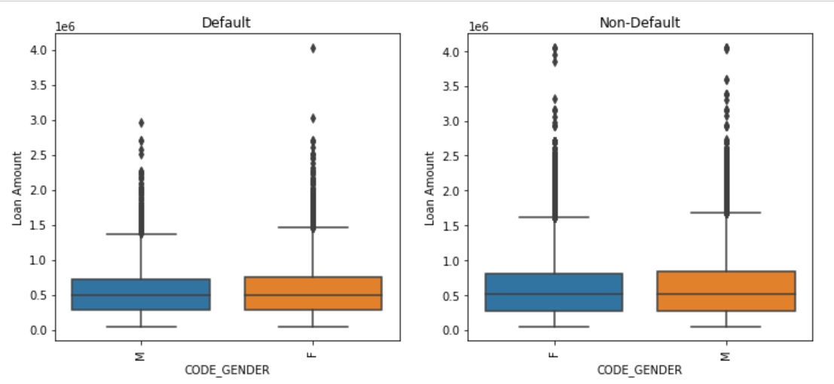
Distribution of Income range
CODE_GENDER vs AMT_CREDIT
Points to be concluded from the boxplots on the right side.
Female slightly more in defaulters.

Slide 22
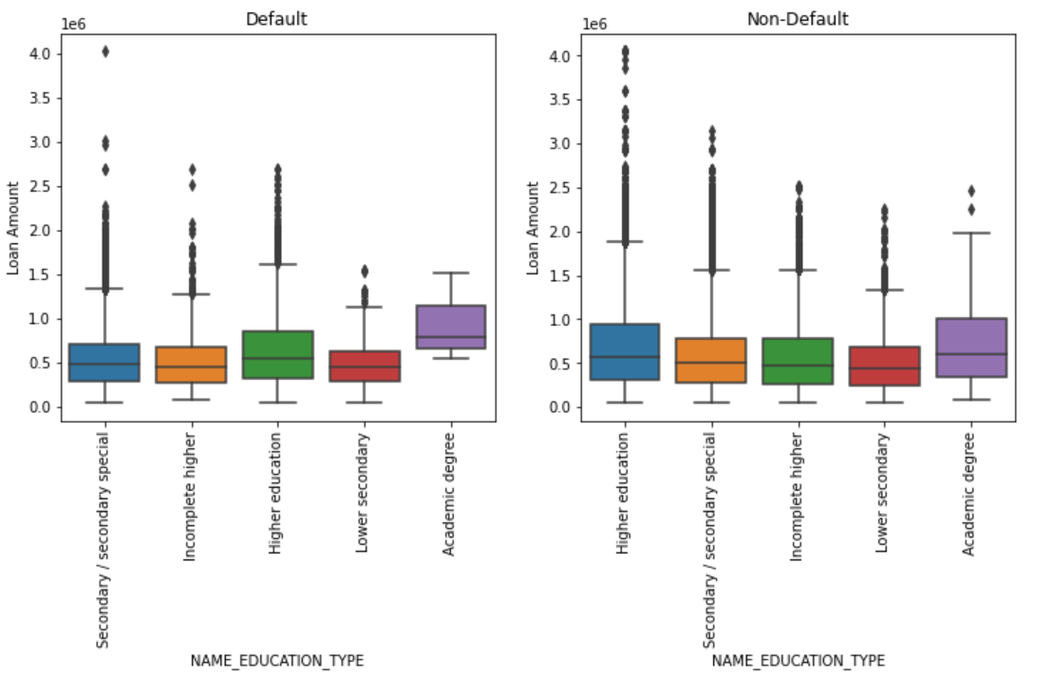
Distribution of Income range
NAME_EDUCATION_TYPE vs AMT_CREDIT
Points to be concluded from the graph on the right side.
People with academic degree and high education have more credits.

Slide 23
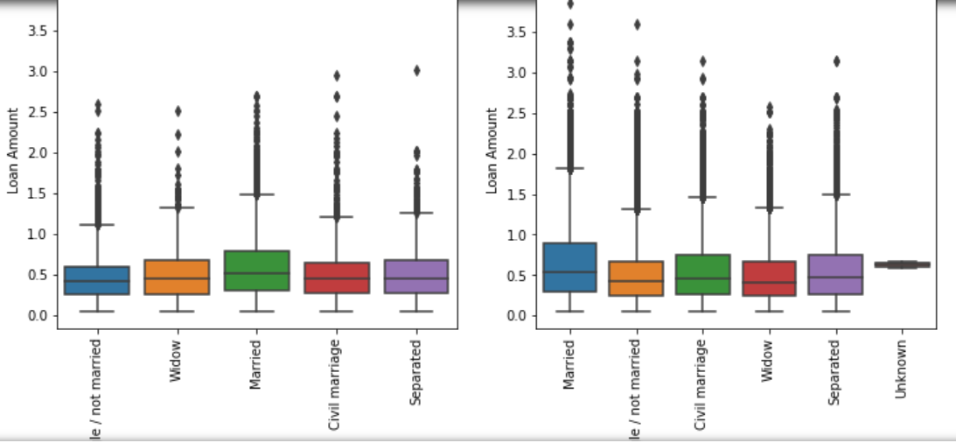
Distribution of Income range
NAME_FAMILY_STATUS vs AMT_CREDIT
Points to be concluded from the graph on the right side.
People who are married, civil married and separated have more credits.

Slide 24
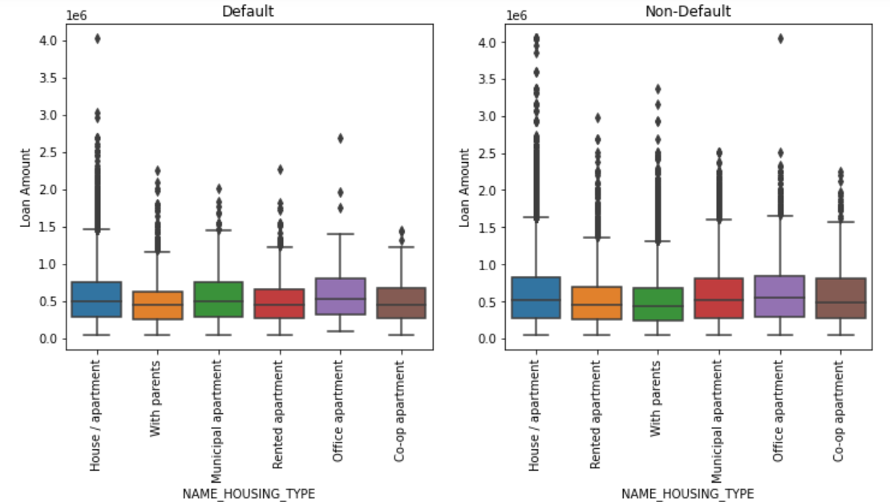
Distribution of Income range
NAME_HOUSING_TYPE vs AMT_CREDIT
Points to be concluded from the graph on the right side.
People living in office apartment are high in number then comes people living in municipal apartment who have more credits

Slide 25
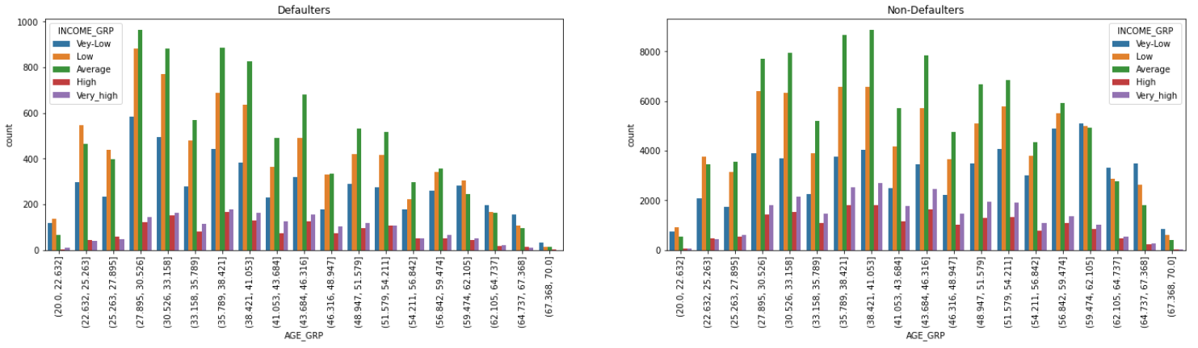
Distribution of Income range
INCOME_GRP vs AGE_GRP
Points to be concluded from the graph on the right side.
People in age group of 27-30 with average incoem are higher in defaulters.
People in age group of 27-59 with average income have higher no in non defaulters

Slide 26
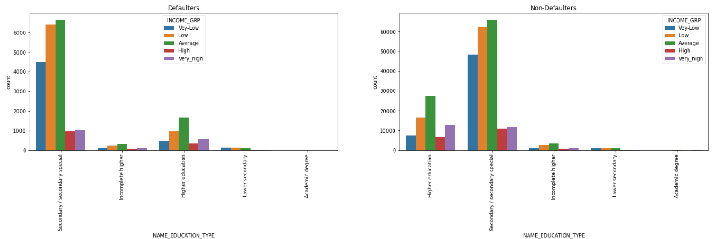
Distribution of Income range
NAME_EDUCATION_TYPE’ vs 'INCOME_GRP
Points to be concluded from the graph on the right side.
People with Secondary education and average income are higher in defaulters and non defaulters...

Slide 27
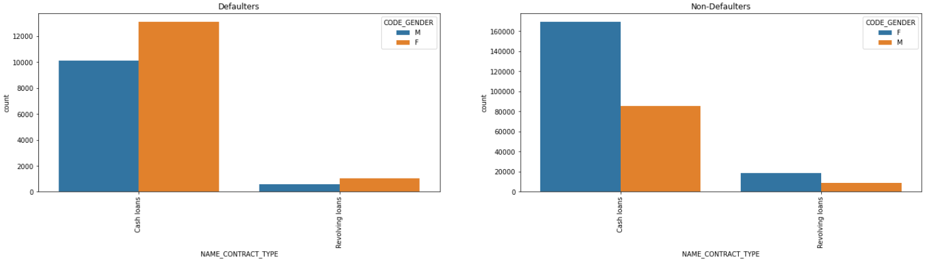
Distribution of Income range
NAME_CONTRACT_TYPE’ vs 'CODE_GENDER
Points to be concluded from the graph on the right side.
Females are higher in defaulters having both cash loans and revolving loans.

Slide 28
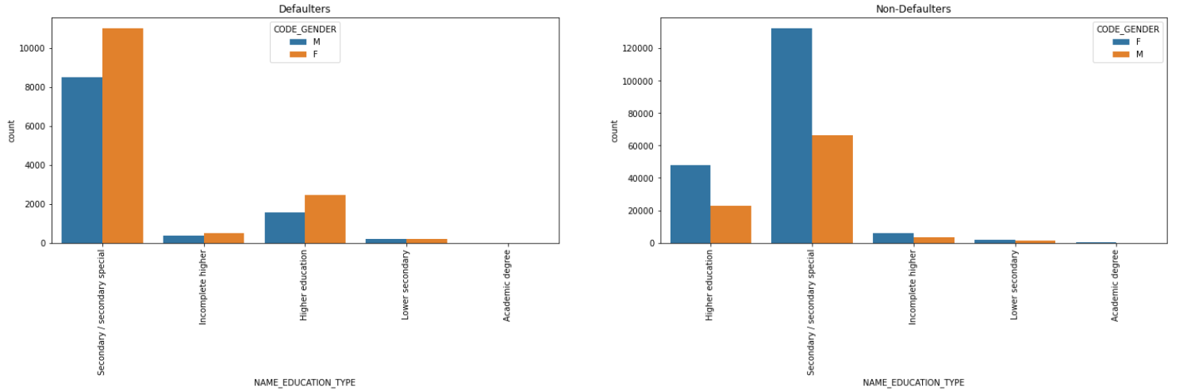
Distribution of Income range
NAME_EDUCATION_TYPE’ vs 'CODE_GENDER
Points to be concluded from the graph on the right side.
Females have higher number in defaulters with secondary education, incomplete higher, higher education

Slide 29
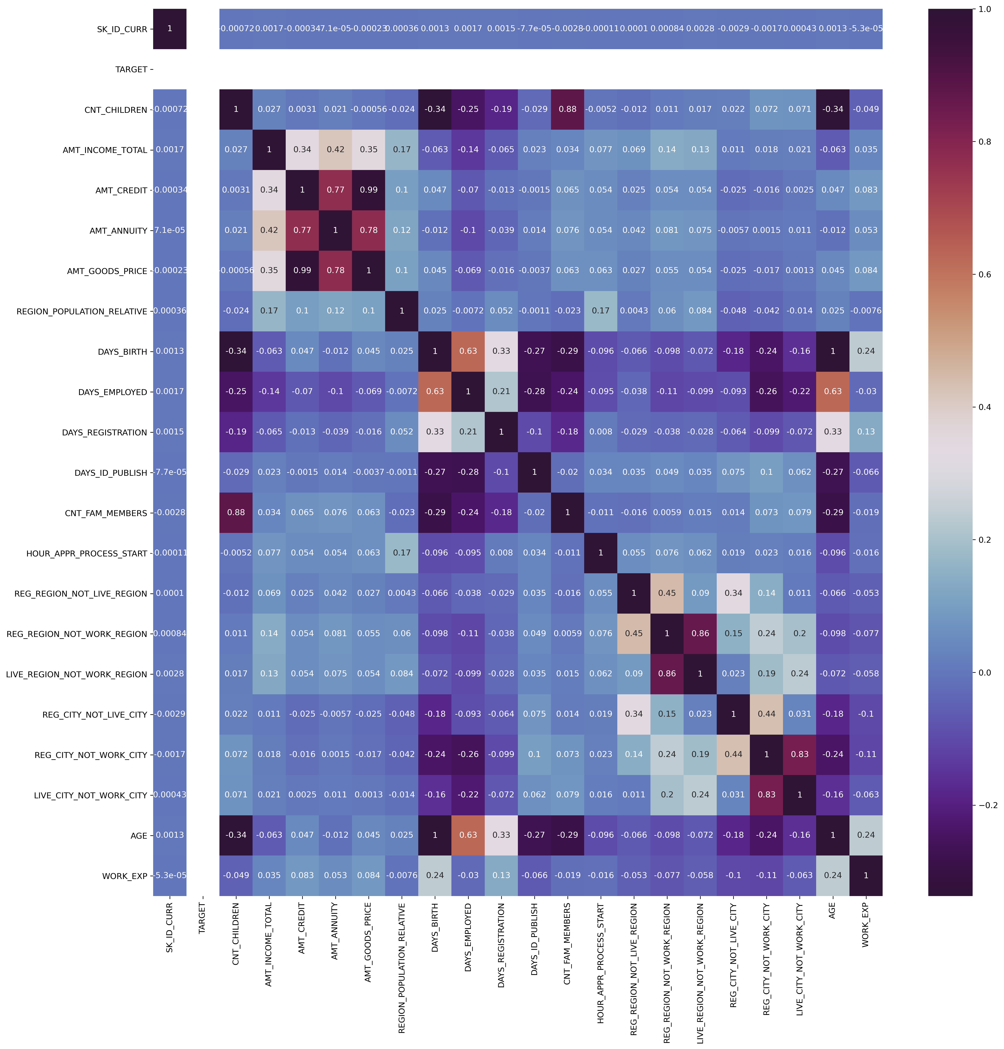
Correlation For target 0(Non -Defaulter)

Slide 30
Conclusion from correlation target 0
Points to be concluded from the graph presented before.
Credit amount is inversely proportional to the date of birth, which means Credit amount is higher for low age and vice-versa.
Credit amount is inversely proportional to the number of children client have, means Credit amount is higher for less children count client have and vice-versa.
Income amount is inversely proportional to the number of children client have, means more income for less children client have and vice-versa.
From heat map we can say that No field is correlated with the TARGET variable so we need some other information to draw conclusions on the target variable.
There is a strong correlation between (AMT_GOODS_PRICE and AMT_CREDIT) and (CNT_FAM_MEMBERS and CNT_CHILDREN ) so we can use any one of them to do regression analysis.

Slide 31
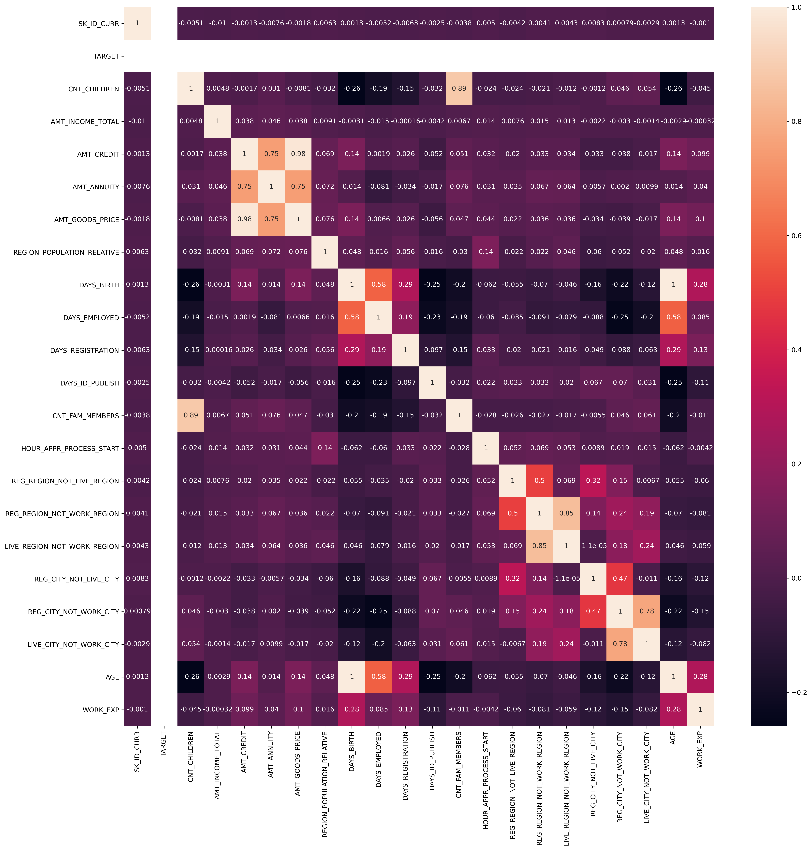
Correlation For target 1(Defaulter)

Slide 32
Conclusion from correlation target 1
This heat map for Target 1 is also having quite a same observation just like Target 0. But for few points are different. They are listed below.
The client's permanent address does not match contact address are having less children and vice-versa
The client's permanent address does not match work address are having less children and vice-versa

Slide 33
conclusion
1. Bank current situation for giving loans:
--Majority of the loans are approved
--99% of the clients chose to pay cash through the bank
-- HC is the reason why majority of applications got rejected
--majority of the clients are repeaters
2. Banks should focus more on clients with
--contract type ‘Student’ ,’pensioner’ and ‘Businessman’ with housing ‘type other than ‘Co-op apartment’ for successful payments.
--from housing type ‘With parents’ as they are having least number of unsuccessful payments.
--family members of 3 or more and owns a car
3. Banks should be cautious with Clients
--in age group 27-30 years with income type 'average' and contract type ‘Working’ and 'Unaccompanied' as they are having most number of unsuccessful payments.
--from housing type 'Rented/ Municipal apartment'
--with loan purpose ‘Repair’
--who are females having education type 'secondary education'/'incomplete higher'/'higher education' and contract type 'cash loans/revolving loans'
-- with Family members of 2 and do not own a car

Slide 34
Thank you

